Slide 1
MBA201
PERFORMANCE MANAGEMENT
Module-5

Slide 2
PERFORMANCE MANAGEMENT:
Objectives of Performance Management, Performance Management and Performance Appraisal,
Common Problems with Performance Appraisals, Performance Management Process,
Types of Performance Rating Systems, Future of Performance Management.
Difference in approach of performance management towards human capital management.
Job Re- Design: Job Rotation, Job Enlargement, Job Enrichment, Job Enhancement

Slide 3
PERFORMANCE APPRAISALS
Definition 1: Systematic Evaluation
“It is a systematic evaluation of an individual with respect to performance on the job and individual’s potential for development.”

Slide 4
Systematic evaluation of present potential capabilities of personnel and employees by their superiors, superiors superior, or professional from outside
It is a process of collecting, analyzing, and evaluating data relative to jobs, and results of individual

Slide 5
Definition 2: Formal System, Reasons and Measures of future performance
“It is formal, structured system of measuring, evaluating job related behaviors and outcomes to discover reasons of performance and how to perform effectively in future so that employee, organization and society all benefits.”

Slide 6
PERFORMANCE MANAGEMENT
Performance management is defined as a continuous process of identifying, measuring, managing, and developing the perfor­mance of individuals and groups in an organization.

Slide 7
PERFORMANCE APPRAISAL
Performance appraisal is the ongoing process of reviews of employee performance over time, and is one component of the entire performance management process. It is a formal system, which requires a manager to carry out this activity in a continuous manner.

Slide 8
Meaning of Performance Appraisals
Performance Appraisals is the assessment of individual’s performance in a systematic way. It is a developmental tool used for all round development of the employee and the organization.

Slide 9
Assessment should be confined to past as well as potential performance also. The second definition is more focused on behaviors as a part of assessment because behaviors do affect job results.

Slide 10
OBJECTIVES OF PERFORMANCE MANAGEMENT
Objective for the Employee
Personal development
Work satisfaction
Engagement in the organization
Objective for the organization:
Provide information about employees and their development
Measure the efficiency with which human resources are being used and improved
Provide linkages to compensation and rewards to employees
Maintain organizational control

Slide 11
PERFORMANCE MANAGEMENT AND PERFORMANCE APPRAISAL
Performance Appraisal | Performance Management
Focus is on performance appraisal and generation of ratings. | Focus is on performance management.
Emphasis is on relative evaluation of individuals. | Emphasis is on performance improvements of individual officer and his departmental or team performance.
Annual exercise⎯though normally periodic evaluations are continuous process with quarterly or periodic performance made. | Continuous process with quarterly or periodic performance made review discussions.
Emphasis is on ratings and evaluation. | Emphasis is on performance planning, analysis, review, development and improvements.
Rewards and recognition of good performance is an important component. | Performance rewarding may or may not be an integral part Defining and setting performance standards is an integral part.

Slide 12
PERFORMANCE MANAGEMENT AND PERFORMANCE APPRAISAL
Performance Appraisal | Performance Management
Designed and monitored by the personnel/administration department. | Designed by the personnel/HR department but could be monitored by the respective depart ents themselves.
Ownership is mostly with the administration/personnel. | Ownership is with line managers; personnel/administration facilitates its implementation.
KPAs and KRAs are used for bringing in objectivity. | KPAs or KRAs are used as planning mechanisms
Developmental needs are identified at the end of the year on the basis of the appraisal of competency gaps. | Developmental needs are identified in the beginning of the year on the basis of the competency requirements for the coming year.
There are review mechanisms to ensure objectivity in ratings. | There are review mechanisms essentially to bring performance Improvements.
It is a system with deadlines, meetings, input, and a format and output. | It is a system with deadlines, meetings, input, output, and a format.
Format-driven with emphasis on those Linked to promotions, rewards, training and development interventions, placements, etc. | Process driven with emphasis on the format as an aid Linked to performance improvements and through them to other career decisions as and when necessary.

Slide 13
COMMON PROBLEMS WITH PERFORMANCE APPRAISALS
Performance appraisal and total quality management.
The second set of problems with the system of performance appraisals is that it is often a flawed process. The common flaws are as follows:
Inaccurate
Infrequent
Comparison with peers
Unsuitable for the millennials

Slide 14
THE PERFORMANCE MANAGEMENT PROCESS
Establish performance standards.
Communicate the standards.
Measure actual performance.
Compare actual performance with standards and discuss the appraisal.
Taking corrective action if necessary.

Slide 15
Establish and communicate expectations for performance.
Observe and measure individual performance against standards.
Reinforce performance to provide remedies.

Slide 16


BASIC PERFORMANCE APPRAISAL PROCESS
Conduct a Job Analysis (e.g., specify tasks and KSAs)
Develop Performance Standards (e.g., define what is superior, acceptable, and poor job performance)
Develop or Choose a Performance Appraisal System

Slide 17



PERFORMANCE APPRAISAL PROCESS
Observation
Selective Attention
Timing
Structure
Frequency
Storage
Encoding of Information (e.g., categorization)
Short vs. Long-term
Memory
Evaluation
Retrieve Information
Combine information
Decision-making (judgment)

Slide 18
PERFORMANCE MANAGEMENT PROCESS
The circular process consists of six interconnected stages :
Contextual preparation
Planning
Execution
Assessment
Review
Renewal of performance.

Slide 19
STEP 1: CONTEXTUAL INFORMATION (ALSO DESCRIBED AS PRE-REQUISITES)
The performance management process, in order to take off successfully in an organization, requires two key prerequisites.
It presupposes that the organization would have clarified its organizational vision, mission and strategy planning.
A mastery over the requirements of the jobs, and more specifically, clear definition of the roles for performing a given job within the organizational framework is the second prerequisite.
The pre-requisite stage also covers one more important element: the commitment and support of the senior leadership and top management. The support is manifested through various steps, which include:
Challenging work for star performers
Healthy investment in learning and development projects
Appropriate structure for dealing with poor performance
Reward and recognition aligned to PMS.

Slide 20
STEP 2: PLANNING
The goals of the performance planning are:
To build agreement on the employee’s job responsibilities.
To clear doubts about targets and objectives that needs to be achieved.
To bring into focus the competencies relevant for the job.
To develop a career development plan for the employee.
Performance plan has the following elements:
Key Accountabilities⎯they are broad areas of a job for which the employee is responsible for producing results.
Specific Objectives⎯they are statements of outcomes a model way to develop outcomes is by using the acronym SMART. SMART stands for specific, measurable, attainable, realistic, and timely.
Performance Standards⎯the performance standards/criteria used in organizations are as diverse as traits, behaviors, competencies, goal achievement, and potential to improve.

Slide 21
STEP 3: PERFORMANCE EXECUTION
Performance execution is the joint responsibility for both the employee and the manager.
Employee responsibility:
Committing to goal achievement
Seek performance feedback
Effective and periodical communication with manager
Collection and sharing of information on performance
Active participation in performance reviews
Manager responsibility:
Creating suitable work environment to motivate the employee
Timely documentation of performance
Updatation of initial goals
Feedback and coaching

Slide 22
STAGE 4: PERFORMANCE ASSESSMENT
Using multiple sources (peers, customers, and subordinates) improves the ownership of the employee and also opens up wider area of information.
Rater problems
Problems with standards of evaluation: perceptual divergence in the use of words (e.g. good, adequate, satisfactory) among multiple evaluators.
Halo effect: assigning values on the basis of an overall impression of the rate, created by a positive first impression.
Leniency or harshness: seeing everything good, or everything bad in a rate.
Central tendency error: avoiding use of high or low ratings, rather rate all employees on an average basis.
‘Recency of events’ error: rating an employee more on the basis of recent past behaviour (e.g., last five weeks) rather than overall performance
Contracts effects: raters let another employee’s performance influence the ratings.
Personal bias (stereotyping, similar to me): rating an employee on the basis of sex, race, and favouritism.

Slide 23
THE CHOICE OF RATERS
TABLE SHOWING A COMPARATIVE EFFICACY OF DIFFERENT RATER SYSTEMS
Rater | Advantages | Disadvantages | Remedies
The immediate supervisor | The supervisor is the most natural choice as he is the one most likely to know what the employee should be doing. | The supervisor may not be in regular contact. In modern organizations with virtual teams, Internet-linked offices, telecommuting, and complexity of tasks, the supervisor may not be familiar either with the employee in person or his tasks. Personal bias might hinder objective evaluation. | Use multiple evaluators, including the supervisor to improve the objectivity quotient.
2. Peers | Often know the job of the employee more closely than the supervisor and are more directly affected by the employee’s actions. In a Team environment , peers can accurately assess the interpersonal competencies of the employee. | Possibilities of a different kind of bias. Ego conflicts and personal biases can colour perceptions of individual employees in respect of their peers. | Can be suitably moderated by the manager based on observed patterns. Possibilities for personal­ity conflicts/bias notwithstanding, peer evaluations can provide clear insight into the inner functioning of a team, especially when the supervisor has infrequent interaction with the team.

Slide 24
Rater | Advantages | Disadvantages | Remedies
The immediate supervisor | The supervisor is the most natural choice as he is the one most likely to know what the employee should be doing. | The supervisor may not be in regular contact. In modern organizations with virtual teams, Internet-linked offices, telecommuting, and complexity of tasks, the supervisor may not be familiar either with the employee in person or his tasks. Personal bias might hinder objective evaluation. | Use multiple evaluators, including the supervisor to improve the objectivity quotient.
2. Peers | Often know the job of the employee more closely than the supervisor and are more directly affected by the employee’s actions. In a Team environment , peers can accurately assess the interpersonal competencies of the employee. | Possibilities of a different kind of bias. Ego conflicts and personal biases can colour perceptions of individual employees in respect of their peers. | Can be suitably moderated by the manager based on observed patterns. Possibilities for personal­ity conflicts/bias notwithstanding, peer evaluations can provide clear insight into the inner functioning of a team, especially when the supervisor has infrequent interaction with the team.

Slide 25
STAGE FIVE: PERFORMANCE REVIEW
At the review meeting the employee and manager discuss the ‘what’ and the ‘how’ of results achieved against performance plans.
The manager and employee should discuss:
Commitments, if any, from the last review meeting.
Specific achievements since the last conversation.
Difficulties hampering performance, the reasons and the ways and means of overcoming them, including use of skills in past achievements.
The implications of changing behaviors.
Action plan for future.

Slide 26
STAGE SIX: RENEWAL
In the last phase, the manager uses insights and learning from the last cycle to more effectively plan performance in the next cycle.
The manager and employee review and make appropriate adjustment of goals in tune with the organization’s mission, vision, values, and strategy. This could lead to setting new objectives and standards, new accountabilities , development of new competencies for the upcoming performance period; and creating the ongoing and continuous nature of the performance management cycle.

Slide 27
THE CRITICAL SUCCESS FACTORS FOR PERFORMANCE MANAGEMENT SYSTEM
Strong commitment from the top management
Alignment with strategy
Alignment with other HR systems
Acceptance by all levels of employees
Adequate organizational training
Automation

Slide 28
TYPES OF PERFORMANCE RATING SYSTEMS
The performance rating systems can be classified into two broad groups:
Relative- ranking ordering,
paired comparisons
forced ranking.
Absolute⎯narrative method or essays,
3. behaviour anchored rating scales,
4.critical incidents,
5.graphic rating scales,
6.management by objectives.

Slide 29
RANK ORDERING
There are two methods:
Simple⎯the rater orders all rates , from lowest to highest.
Alternation⎯also referred to as multi-person comparison methods, each employee’s performance is matched with that of her peers, eventually producing a rank order from top to bottom.

Slide 30
PAIRED COMPARISON
It is a method of evaluation in which each employee is compared with each other employee. Scores derived from paired comparison are often compared with the standard deviation and mean of all scores to arrive at standard scores for future comparisons.
In this method, the number of pairs of rates to be compared may be calculated from the formula n (n-1)/2, n denoting the number of employees.
Example, if a firm has just 10 employees , all 10 individuals will be compared in this process , (10(9))/2 , requiring 45 comparisons .
The rater’s task is simply to choose the better of each pair and each individual’s rank is determined by counting the number of times he or she was rated superior.

Slide 31
FORCED RANKING
It is also known as vitality curve, rank and yank and forced distribution.
The forced ranking system is based on the much debated assumption that ratees confirm to a pattern of normal distribution.
One of the criticism of forced ranking system is that the system may introduce a great deal of error, if a group of ratees do not confirm to the usual distribution and may ,as a group, be either superior or substandard.
In short, rather than eliminating error, forced distribution may introduce another kind of error.
It may lead to unintended negative effects on employee morale, teamwork and collaboration, thus affecting shareholder perceptions.

Slide 32
THE NARRATIVE OR THE ESSAY METHOD
One of the simplest among absolute ratings, a rater is required to write a description of the ratee’s performance, his strengths, weaknesses and areas of improvement.
The narrative structure provides the rater with the opportunity to make their evaluative assessment form that can go beyond a mere ticking of a box.
The underlying belief is that a rater who is conversant with the rate and his work can produce a narration which can be as powerful as acceptable as a formal appraisal system. Narratives can be used alone, or combined with another method or form.
The positives of a properly executive Narrative rating include scope for detailed feedback.
The difficulties with this form are: sans quantitative information, comparisons between individual employees, groups or teams become virtually impossible.

Slide 33
CRITICAL INCIDENTS METHOD
The ’critical incident method’ is a set of procedures used for collecting direct observations of employee behavior which have critical significance and meet methodically defined criteria.
Critical incidents refer to reports prepared by knowledgeable observers of specific employee behaviors that focus on either particularly outstanding behaviors or particularly questionable behaviors. Supervisors document critical incidents as they occur usually in a file folder (kept for each employee, either a hard copy or an electronic one).

Slide 34
Advantages⎯they provide rich source of data, represent the employee’s perspectives adequately, and can capture rare incidents which may not be captured in any other formal method. The supervisors can concentrate on actual behaviour on job, rather than exercising one’s mind about abstract traits, and use them to provide meaningful feedback to the rates.
Disadvantages⎯excessive reliance on memory, requirement of accurate and truthful reporting of them, a bias for recent events, and difficulty experienced by employees in telling a complete story in necessary details. The supervisors may resend the workload arising out of meticulous process of documentation, and give it low priority, as a consequence of which the feedback

Slide 35
GRAPHIC RATING SCALES
The ratees get evaluated on a continuum with anchor points that demarcate levels of effectiveness. For each ratee, the level of effectiveness is indicated at specific points on the continuum. The scale typically features a Likert scale.
The number of points on the rating scale can vary from 1-3, 1-5, or 1-9 with the maximum end point of 5 to 9 being considered suitable to yield the highest quality of ratings on the basis of research.
Advantages⎯adaptability to a diverse variety of formats, user friendly, easy to construct, have quick process and have face validity.
Graphic rating scales can be differentiated based on the type and amount of information presented in the anchors. The common formats include fuzzy adjectives (e.g., ‘marginal’, ‘average’, or ‘outstanding’ or ‘Poor’, ‘Average’, and ‘Excellent’) as anchors.

Slide 36
Table A Factor in a ‘graphic rating scale’
HCareless worker. Tends to repeat some types of errors
Work is sometimes unsatisfactory because of errors or untidiness.
Usually turns out acceptable work. Not many errors.
Checks and observes his work. Can be relied upon.
Work is of highest quality. Errors extremely rare, if any. Little wasted effort.
Comments _________________________________________________
ow would you rate this employee in respect to the quality of work he turns out , the neatness and accuracy evident in the job he does?

Slide 37
BEHAVIORALLY ANCHORED RATING SCALES
BARS comprises five to ten vertical scales, depending on the nature of the job under review. Each scale describes a key performance dimension of the job. Each dimension is typically depicted by five or more critical incidents corresponding to ‘highly effective’ to ‘highly ineffective’ visible job behaviours on the job dimension.
Disadvantages⎯inter-rater reliability and rater errors (due to multiple developmental processes and formats) and high cost associated with the employee time and effort required to develop and use the instrument.

Slide 38
SAMPLE BEHAVIORALLY ANCHORED RATING SCALE FOR SALES PERFORMANCE BY SALES TRAINEE
Excellent | 7 | Can expect the trainee to make valuable suggestions for increased sales and to have positive relations with customers all over the country.
Good | 6 | Can expect to initiate creative ideas for improvement of Sales.
Above average | 5 | Can expect to keep in touch with the customer throughout the year.
Average | 4 | Can manage, with difficulty, to deliver the goods in time.
Below Average | 3 | Can expect to unload the trucks when asked by the supervisor.
Poor | 2 | Can expect to inform only some of the customers.
Extremely Poor | 1 | Can expect to take extended Tea/Lunch breaks and loiter without purpose.

Slide 39
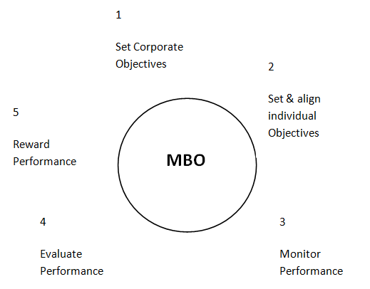
MBO
MBO implies a management approach by which employees participate in a vertically cascading process of setting objectives, covering production, costs, sales and profits, together with their superiors.
The goals set in the participative manner become the basis of subsequent periodical evaluation and rewards.

Slide 40
BALANCED SCORECARD
It is a strategic performance management tool that can be used by managers to keep track of the execution of activities by the staff within their control and to monitor the consequences arising from these actions. It talks about four domains of performance:
Financial: measures which answer the question "How do we look to shareholders?" Examples: cash flow, sales growth, operating income, return on equity.[
Customer: measures that answer the question "How do customers see us?" Examples: percent of sales from new products, on time delivery, share of important customers’ purchases, ranking by important customers.
Internal business processes: measures that answer the question "What must we excel at?" Examples: cycle time, unit cost, yield, new product introductions.
Learning and growth: measures that answer the question "How can we continue to improve, create value and innovate?” Examples: time to develop new generation of products, life cycle to product maturity, time to market versus competition.

Slide 41
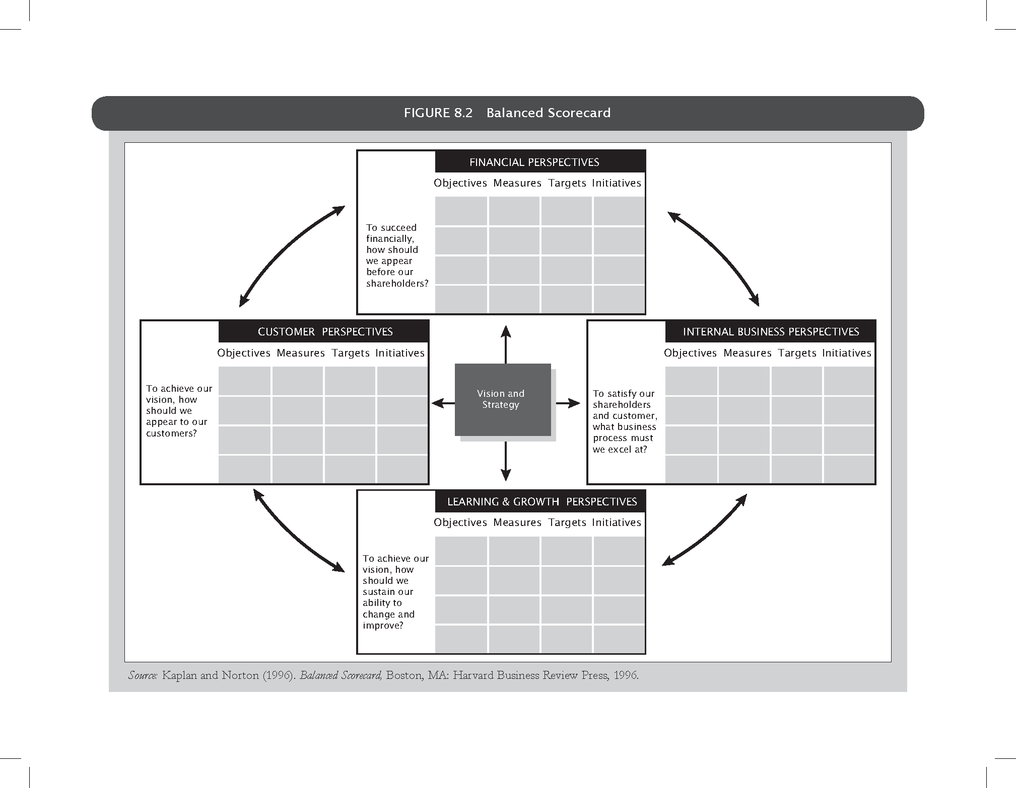

Slide 42
FUTURE OF PERFORMANCE MANAGEMENT
Performance Management system, like all HR processes have witnessed disruptions.
The most debated component of PMS seems to be the used of forced ranking or Bell curve.
The annual 'performance management' process has yielded place to a new 'performance achievement' system.
The focus is on real-time, forward-looking conversations about setting priorities, growing strengths and creating rewarding career opportunities for employees.
With a holistic view of performance management, the future process will foster achievements and talents of each employee with the help of leaders, who will spend more time coaching and talking with employees.

Slide 43
METHODS OF PERFORMANCE APPRAISAL
INDIVIDUAL EVALUATION METHODS
1. Confidential reports
2. Essay evaluation
3. Critical incident
4. Checklists
5. Graphic rating scale
6. Behaviorally Anchored Rating Scales
7. Forced choice method
8. MBO

Slide 44
MULTIPLE REASON EVALTUION METHOD
9. Ranking
10. Paired comparison
11. Forced distribution

Slide 45
OTHER METHODS
11. Group appraisal
12. HRA
13. Assessment centre
14. Field review

Slide 46
METHODS OF PERFORMANCE APPRAISAL
TRADITIONAL METHODS
1. Graphic rating scale
2. Ranking method
3. Paired comparison method
4. Forced distribution method
5. Checklist method
Simple
Weighted
Critical incident method
6. Essay appraisal
7. Group appraisal
8. Confident reports

Slide 47
MODERN METHODS
9. B.A.R.S
10. Assessment centre
11. H.R accounting
12. MOB
13. Psychological appraisal

Slide 48
CONFIDENTIAL REPORT
Government organization
Descriptive report prepared at the end of every year by the employees immediate superior
Strengths and weaknesses of the subordinates
Impression of superior is recorded, no feedback
Confusions of appraisee

Slide 49
ESSAY TECHNIQUE
Describe in detail the quantity and quality of the employee’s performance during the past twelve months.
Describe the employee’s strength and weakness.
How do you describe the employee’s potential within the company?
What leadership skills does the employee bring to the job?
What future development activities do you recommend for the employee?

Slide 50
CRITICAL INCIDENT TECHNIQUE
Manager prepares list of statements of every effective and ineffective behavior of an employee
These critical incidents represents outstanding or poor behavior of employees on the job
Logs are maintained
Objective basis for conducting a thorough discussion of an employee

Slide 51
CHECKLISTS AND WEIGHTED CHECKLISTS
A set of objectives or descriptive statements about the employee and his behavior
If the rater believes strongly that the employee possesses a particular listed trait he checks the item or leaves it blank
Variation to checklist is weighted list
Expensive and time consuming

Slide 52
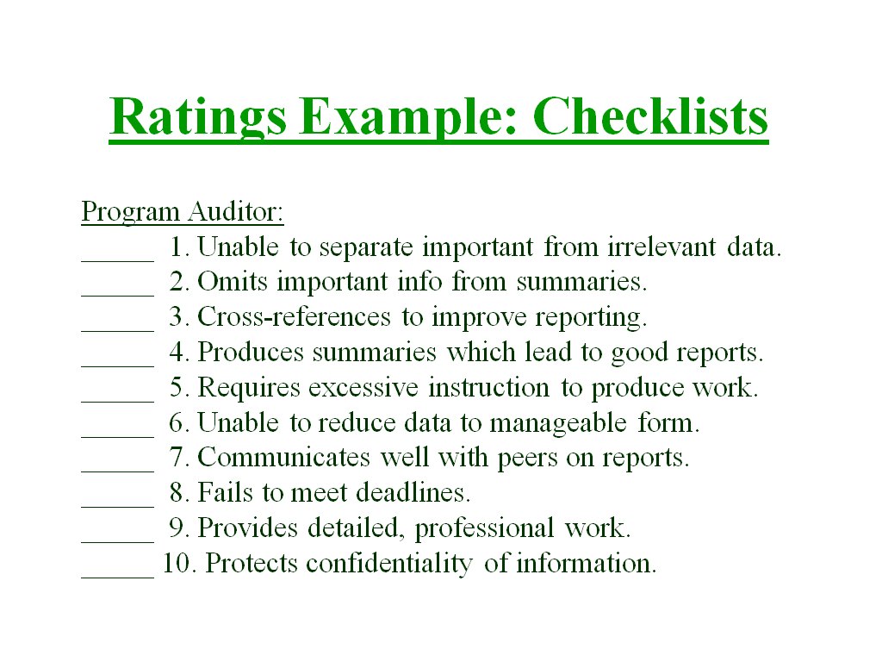

Slide 53
GRAPHIC RATING SCALE
Graphic Rating Scale: A performance appraisal that rates the degree to which the employee has achieved various characteristics.
  The graphic rating scale is the most common type of appraisal used.
  Various characteristics such as job knowledge or punctuality are rated by the degree of achievement.
    The rate usually receives a score of 1 to 5, with 5 representing excellent performance.
    Some forms allow for additional comments.

Slide 54
PAIRED-COMPARISON APPROACH
A performance appraisal that measures the relative performance of employees in a group.
  This is a method of performance evaluation that results in a rank ordering of employees to come up with a best employee.
  This type of approach measures the relative performance of employees in a group.

Slide 55
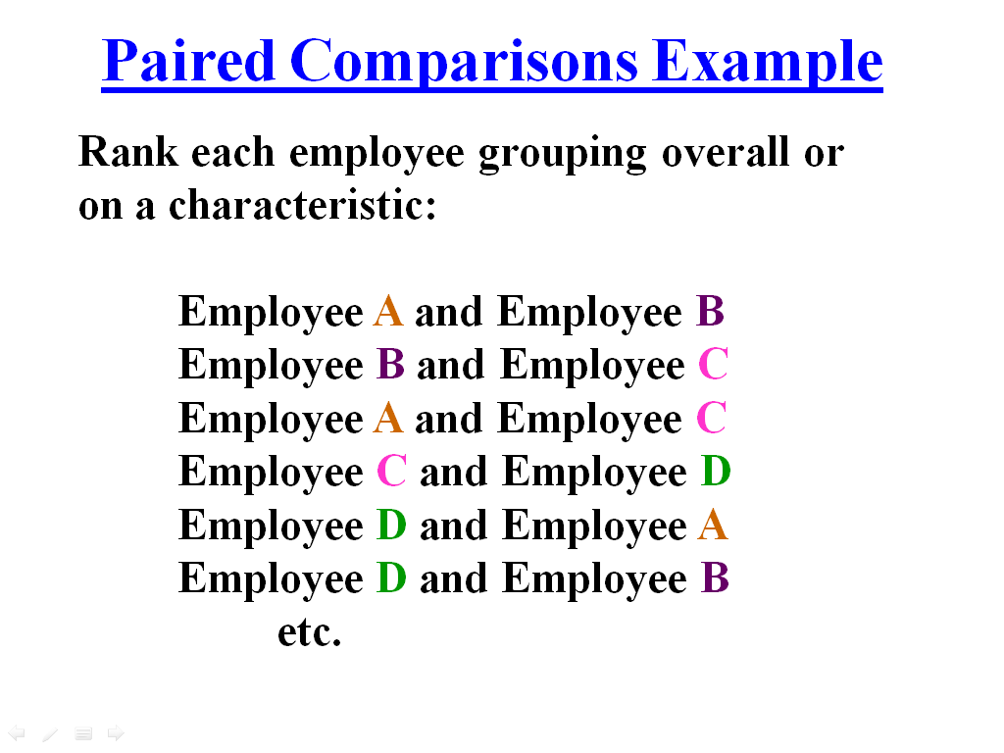

Slide 56
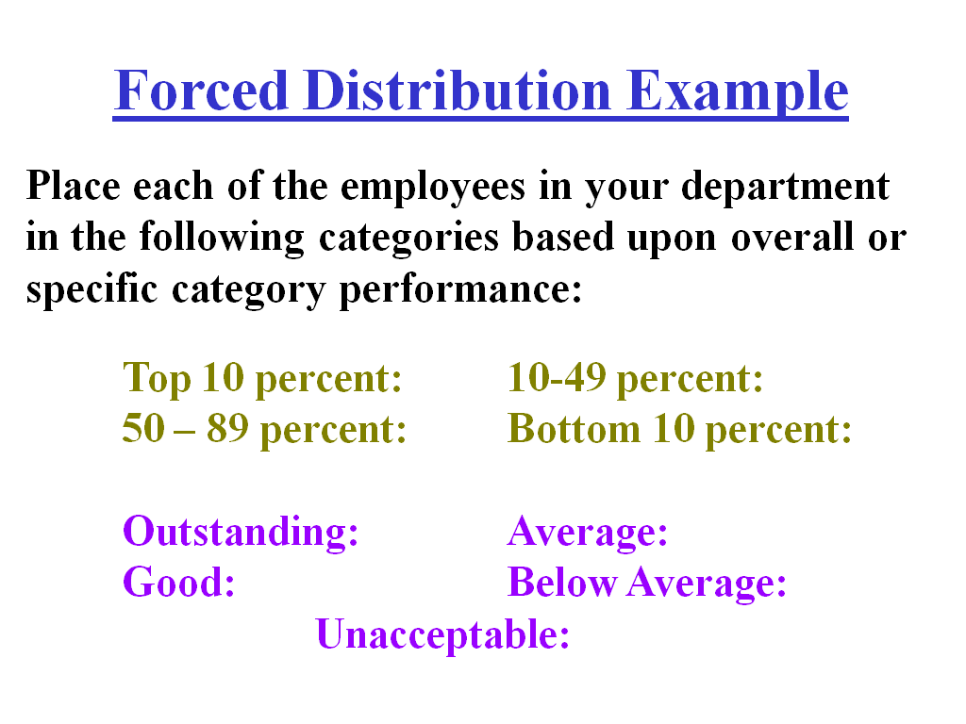

Slide 57
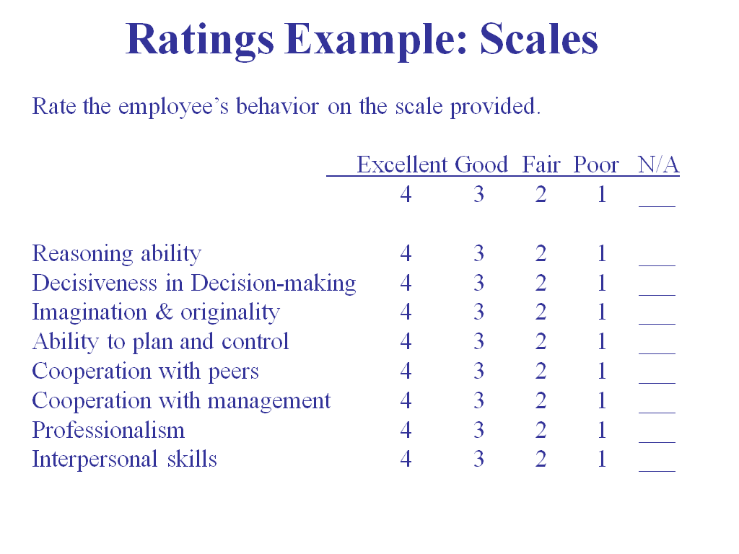

Slide 58
BEHAVIORALLY ANCHORED RATING SCALES
Behavioral expectation scale-latest innovation in performance appraisal
It is a combination of rating scale and critical incident techniques of employees performance evaluation
The CI serve as anchor statements on a scale and the rating form usually contains six to eight specifically defined performance dimensions
Collect CI
Identify performance dimensions
Reclassification of incidents
Assigning scale values to the incidents
Producing the final instruement

Slide 59
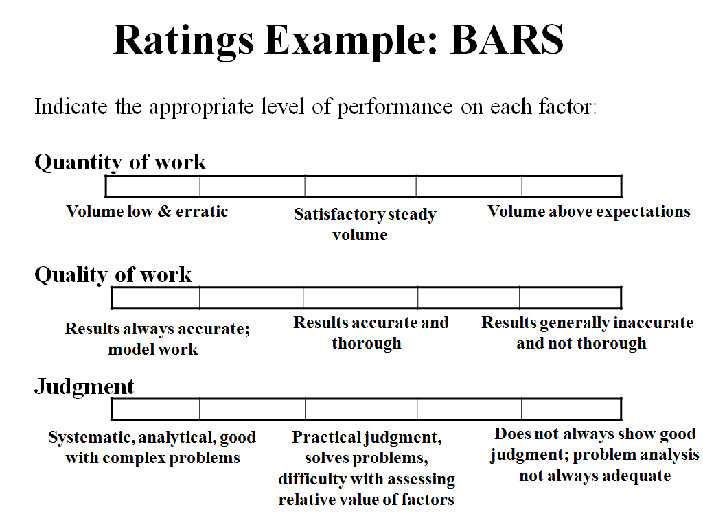

Slide 60
FORCED CHOICE METHOD
To eliminate bias and the preponderance of high ratings that might occur in some organizations.
The primary purpose of the forced choice method is to correct the tendency of a rater to give consistently high or low ratings to all the employees.
Several sets of pair phrases, two of which may be positive and two negative and the rater is asked to indicate which of the four phrases is most and least descriptive of a particular worker.

Slide 61
MANAGEMENT BY OBJECTIVE
MBO requires the management to set specific, measurable goals with each employee and then periodically discuss the latter's towards these goals.
Technique emphasizes participative set goals that are tangible, verifiable, and measurable.
What must be accomplished rather how it is accomplished.
It is a kind of goal setting and appraisal programme involving six steps.

Slide 62
STEPS - MBO
Set the organizations goal
Set departmental goals
Discuss departmental goals
Define expected results
Performance reviews
Provide feedback

Slide 63
RANKING METHOD
Ranking of an employee is done against that of an another employee.
The relative position of each employee is expressed in terms of his numerical rank.
It may also be done by ranking an employee on his job performance against another member of a competitive group.
Relative levels of performance
Highest lowest on some overall criteria
Whole man is compared with another whole man

Slide 64
GROUP APPRAISAL
Employee is appraised by a group of appraisers
Immediate supervisors, other supervisors, managers, head of the departments, and consultants.
It uses any one of multiple techniques discussed earlier
This eliminates personal bias, to a large extent as performance is evaluated by multiple raters
Time consuming

Slide 65
HUMAN RESOURCE ACCOUNTING
Sophisticated method to measure effectiveness of HR in an organization
It is the process for accounting for people in an organization
It tries to place a value on organizational HR as assets and not as expenses
The HRA process shows the investment the organization makes in its people and how the value of these people changes over time
The acquisition cost is compared with replacement cost from time to time

Slide 66
ASSESSMENT CENTER
This method of appraising was first applied in German army in 1930 later business and industrial houses started using this method
It is not a performance appraisal in itself
Assessment is done by various experts using various techniques
Different department employees are bought together to spend two or three days working on similar individual and group assignment
Evaluation is done for various requirements

Slide 67
FIELD REVIEW METHOD
Where subjective performance measures are used, there is a scope for raters biases influencing the evaluation process.
To avoid this some employees use the field review method.
Employee performance been listed on field by a supervisor for immediate manager, a report
This report been used for various purpose
This ratings are done on standardized forms

Slide 68
360 DEGREE FEEDBACK SYSTEM
System collects performance information from multiple parties, including ones subordinates, peers, supervisors and customers.
Developed as a fact finding and self-correction technique it is currently used to design promotion and reward.
Feedback from multiple sources
It can be a sensitive issue
It will fail if not designed and implemented properly

